Slide 1
Heart disease prediction using supervised machine learning algorithms as well as an improved ensemble learning technique: Performance analysis & comparison

Slide 2

Introduction
Heart disease.
What is machine learning?
Supervised machine learning.
Ensemble technique.
Why is an ensemble technique called improved?

Slide 3
Project Overview
This project is about heart disease prediction using supervised machine learning algorithm. Along with these, we also used an improved ensemble technique named voting classifier is used to enhanced the performance of our aim. Five supervised machine learning algorithm is used in this project. They are- Logistic regression, Decision tree, Support vector machine, Random Forest, KNN. Max voting technique is applied on best accuracy given classifier algorithm though it gives use same accuracy of RF and DT. Among all these, highest accuracy is achieved from decision tree, random forest and max voting which is 97.0779%. Difference performance metrics are also calculated in this project.

Slide 4
Objective
Main objective of this project is-
To analyze heart disease dataset using several classifier algorithm.
To apply an ensemble technique to enhance the performance metrics.
To make a comparison among them to decide which one is efficient and potential for utility purpose.
To achieve the highest result to our aim.

Slide 5
Prior work on Heart disease by using machine learning & our Goal
A lot of work has done on the heart disease dataset that we have used in this project. Different classifier algorithms had applied for better outcome. There are vast research work who had done their work by analyzing different classifier algorithms. There are also a lot of recent works that represents the application of different ensemble technique and their comparison. So we tried to consider both of these in our work.
Previously this dataset contained only 313 rows 14 columns of information whereas it is containing 1025 rows and 14 columns. So, doing work on this dataset will never be stoppable. That's why we have took the opportunity.

Slide 6
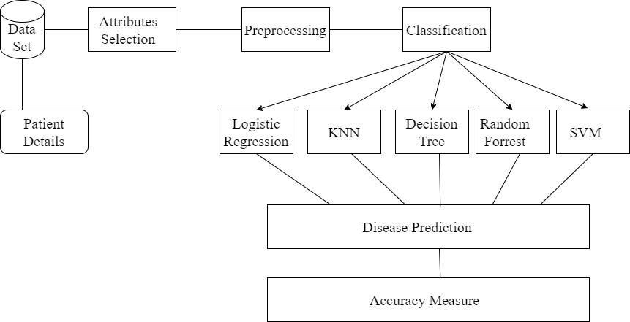
Architecture of Prediction system

Slide 7
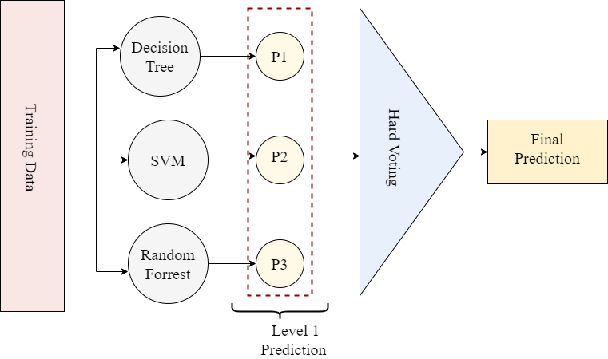
Max Voting Procedure

Slide 8
Experimental setup/methodology of the system

Slide 9
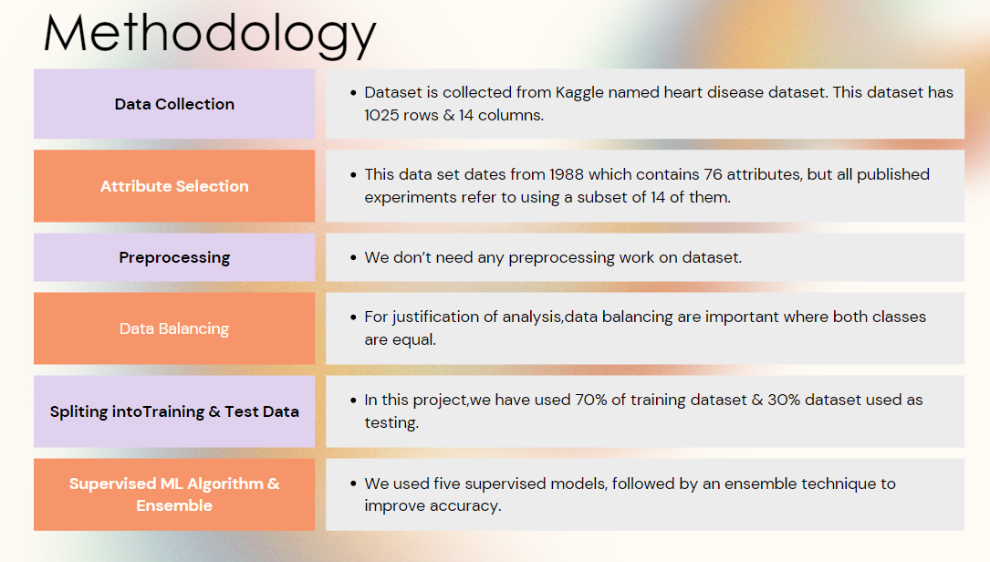

Slide 10
Split Dataset
Train Dataset
Compare Algo

Slide 11
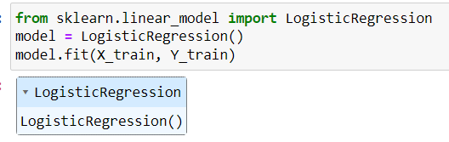
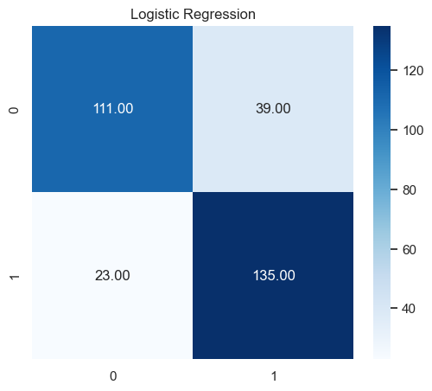
Logistic Regression
Accuracy Score | 79.870%
Precision Score | 77.59%
Recall Score | 85.44%
F1 Score | 81.33%

Slide 12
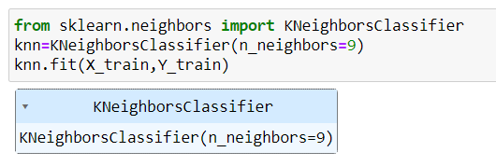
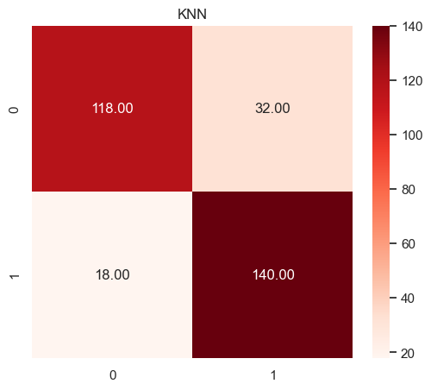
K-Nearest Neighbor
Accuracy Score | 83.77%
Precision Score | 81.40%
Recall Score | 88.61%
F1 Score | 84.85%

Slide 13
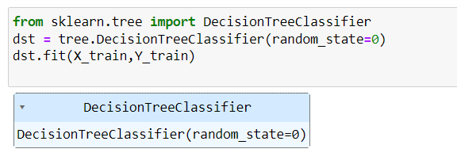
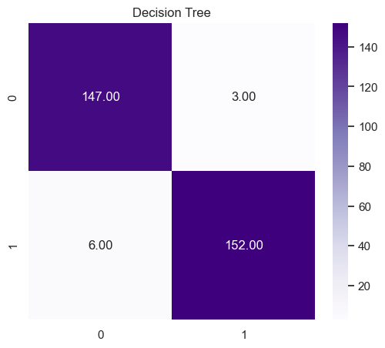
Decision tree
Accuracy Score | 97.08%
Precision Score | 98.06%
Recall Score | 96.20%
F1 Score | 97.12%

Slide 14
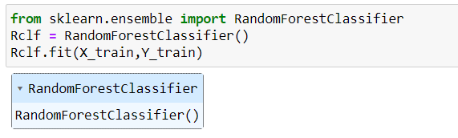
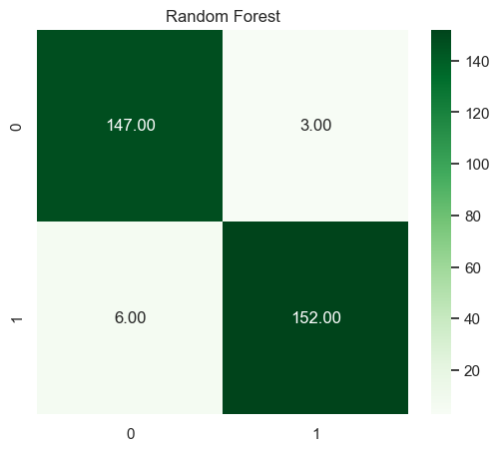
Random forest
Accuracy Score | 97.08%
Precision Score | 96.20%
Recall Score | 98.06%
F1 Score | 97.12%

Slide 15
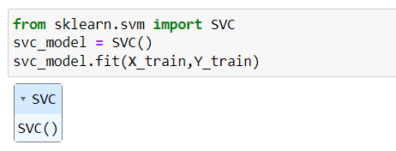
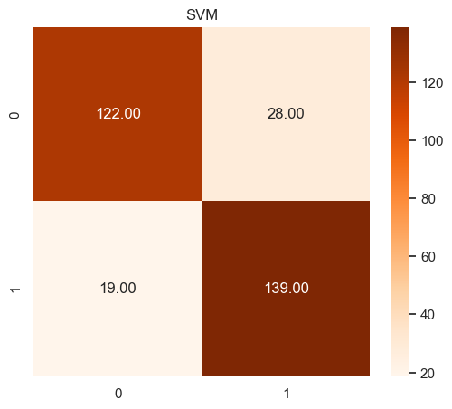
Support Vector Machine
Accuracy Score | 84.74%
Precision Score | 83.23%
Recall Score | 87.97%
F1 Score | 85.53%

Slide 16

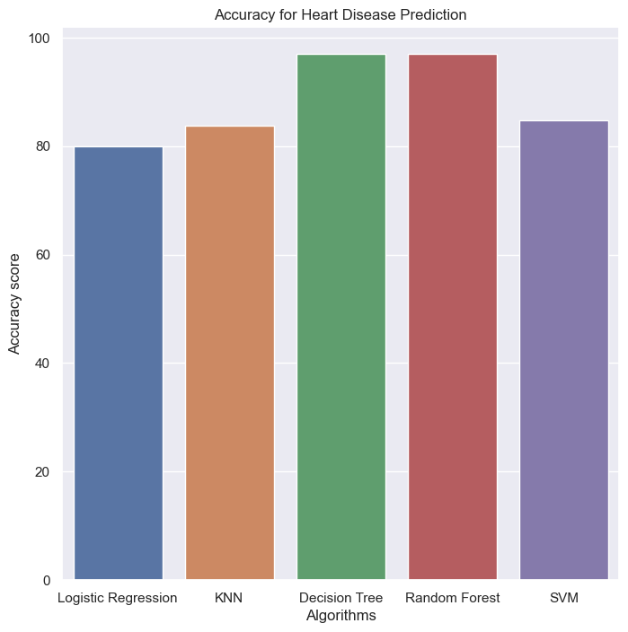
Result & Analysis
Logistic Regression
SVM
KNN
Decision tree
Random Forest

Slide 17
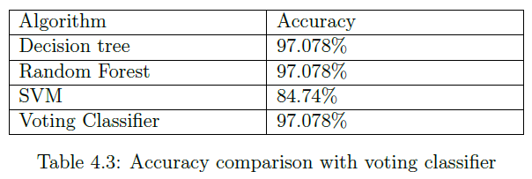
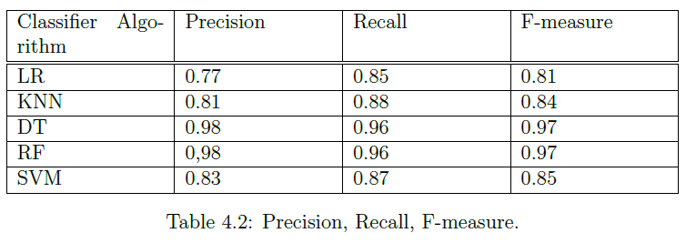
Result & Analysis

Slide 18
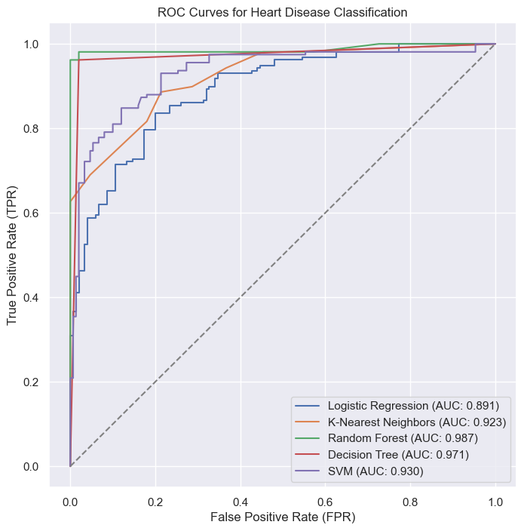
Result & Analysis
Logistic Regression
SVM
KNN
Decision tree
Random Forest

Slide 19
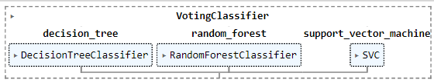
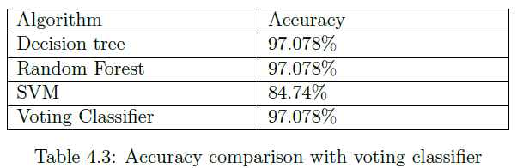
Result & Analysis

Slide 20
Future Work
Integration of multi-modal data including genetic, clinical, and imaging data, to improve prediction accuracy
1
Deep learning techniques, such as convolutional neural networks (CNNs) and recurrent neural networks (RNNs), can be further explored for feature extraction and prediction.
2
Developing models that can provide real-time monitoring and early detection of heart disease risk can be highly beneficial.
3

Slide 21
Conclusion
Though we have used an ensemble technique for performance enhancement but it gives us the same accuracy of random forest and decision tree which is 97.078%. Thus we don't need to go for ensemble technique as simple supervised classifier algorithm can do it properly that increases the system utility.

Slide 22
Thank You

